Slide 1
Product review site
User manual

Slide 2
Table of contents
Acknowledgements
Introduction
About clevered internship
About app
How to use the app
Demo video
User toolkit

Slide 3
acknowledgements
Thank you to everyone who helped me reach this far. My parents, teachers, and all the help from websites like Kaggle, etc.

Slide 4
introduction
My name is Hayqa Imran.
I am 16 years old.
I am about to finish 12th grade this year.

Slide 5
About clevered internship
Currently it has been a great experience as I have learned many new things which I did not know about before , like how to make text to voice codes and how to make a GUI etc.

Slide 6
About app
This is a review app which will show the most talked about things in the reviews given.
The main menu will ask you for the dataset and then will asses it and then show the most repeated words

Slide 7
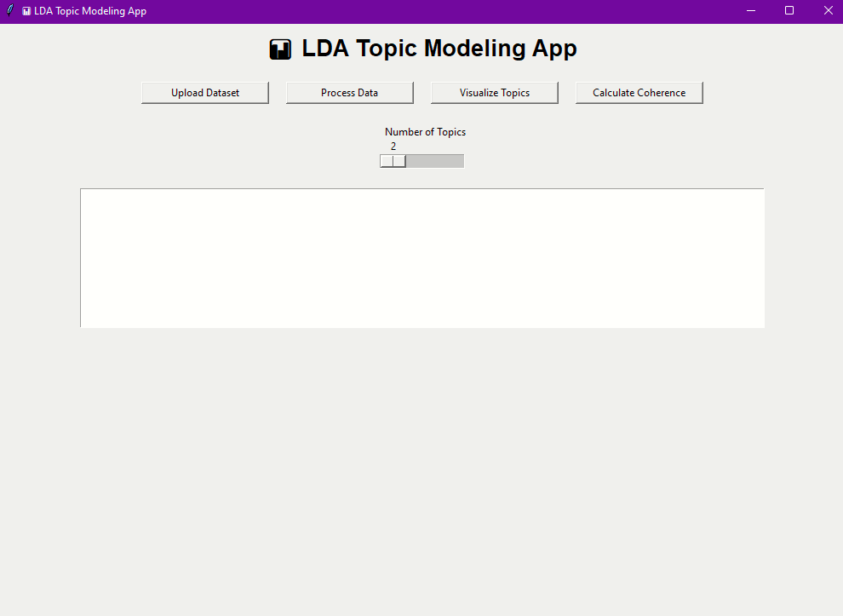
How to use the app
When opened, you will see the main interface. There you will upload your data for the reviews you have by clicking ‘upload dataset’

Slide 8
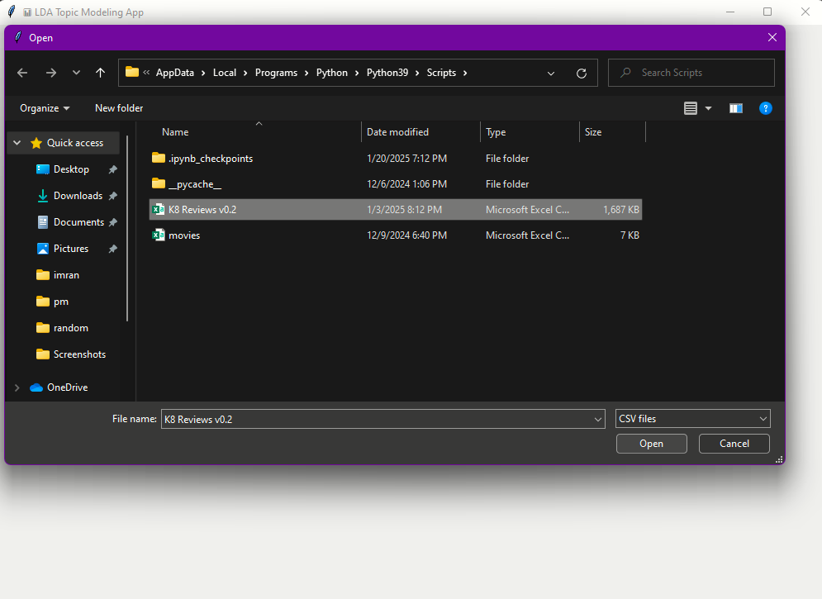
Uploading data
Select you dataset

Slide 9
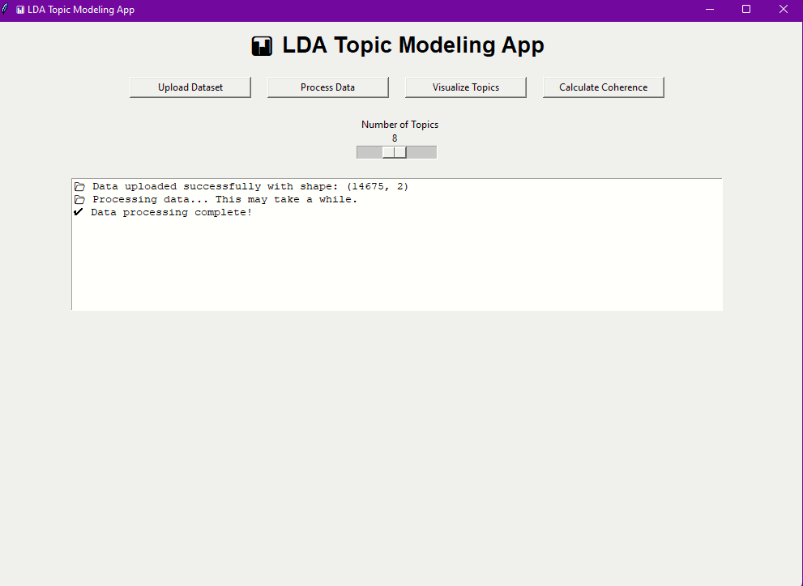
Processing data
After uploading the data, you can adjust the amount of topics you want and then click ‘process data’ . This will take some time

Slide 10
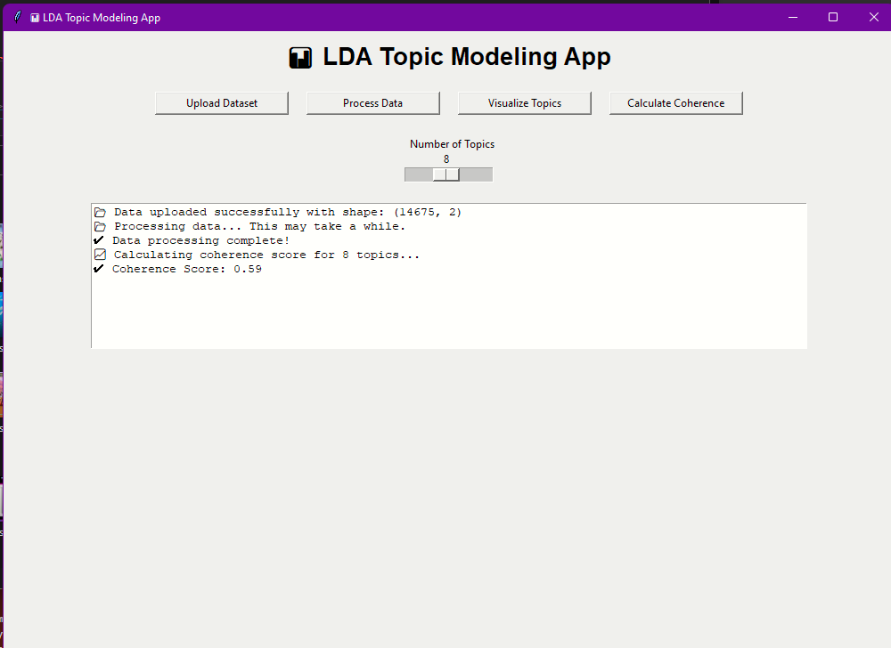
Calculating coherence
After that you need to calculate coherence of the data by clicking the ‘calculate coherence’ button

Slide 11
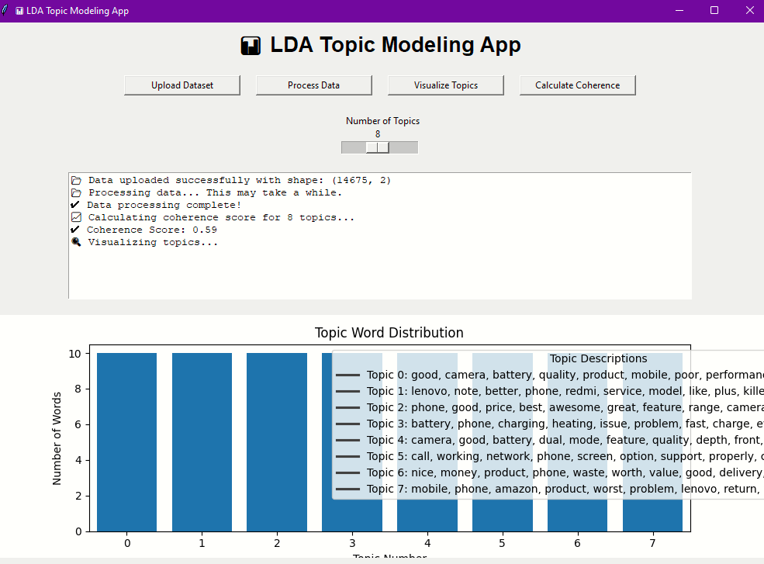
visualizing
Then in the last step, you can visualize the data by clicking the ‘visualize data’ button which will show the most frequent key words in the data

Slide 12
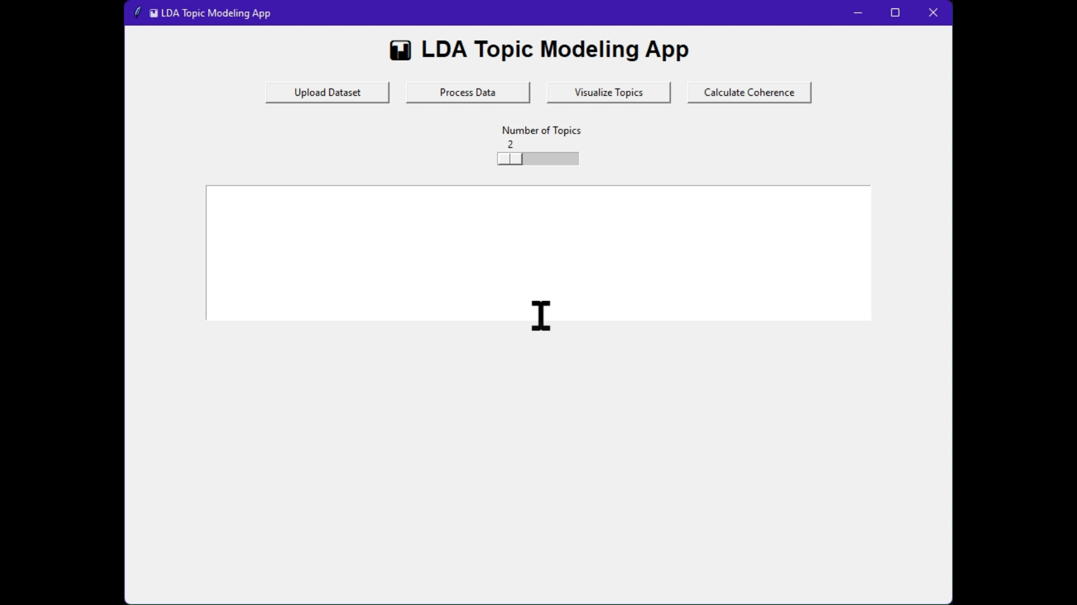

Slide 13
User toolkit
https://docs.google.com/spreadsheets/d/1Kjhmq2eIrNRImS9Unun1AnME2RauY66q/edit?usp=sharing&ouid=114713838330981665095&rtpof=true&sd=true
For any suggestions or bugs, please reach out to Hayqa at m.ghafran@gmail.com

Slide 14
Thank you

